Slide 1

Lecture 3 – Materials and Molecules Generation
김지한 (카이스트)
8.20.2021

Slide 2
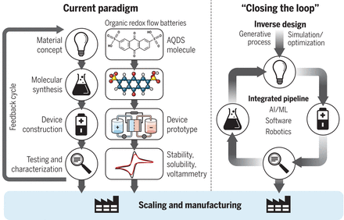
Materials and Inverse Design
One of the major goals in computational materials design is the concept of inverse design.
Inverse design: Property goal → Material (as opposed to materials → property).

Slide 3
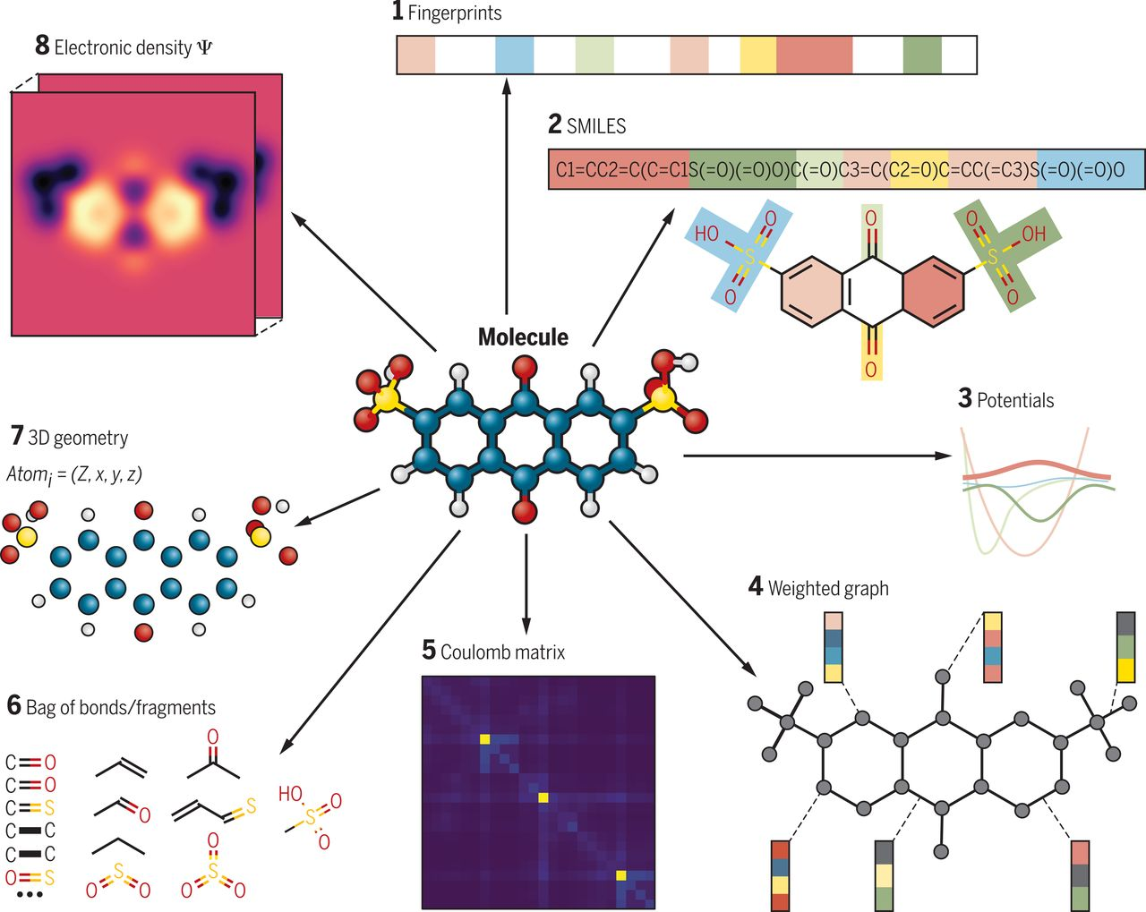
Molecules/Materials Representation Revisited

Slide 4
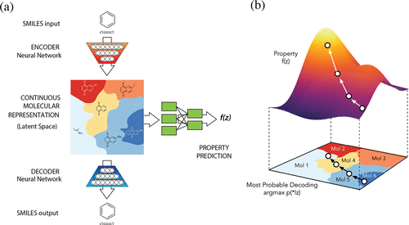
SMILES and Molecule Generation
From paper: Automatic Chemical Design Using a Data-Driven Continuous Representation of Molecules
The authors transformed SMILES (discrete representation) into a continuous vector and used something called autoencoder to generate new molecules.
To show how this is done, we again take a look at the MNIST example.

Slide 5
From Molecules to Materials
One can think that generating materials will be something similar to generating molecules.
That is, we can start with the SMILES representation of the materials and then proceed to generate new materials via VAE.
One problem is that materials (crystalline) are pretty much infinite so it becomes problematic to represent them in SMILES.
Also, with materials, the lattice parameters matter greatly and somehow this information needs to be encoded.
Moreover, materials need to abide by the strict periodic boundary conditions whereas molecules do not need to worry about periodic boundary conditions.

Slide 6
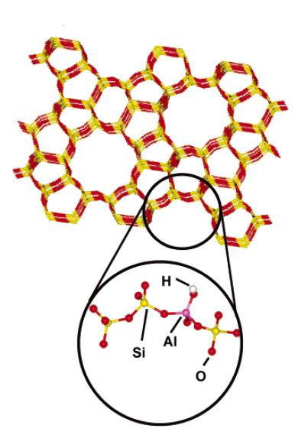
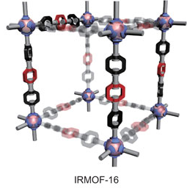
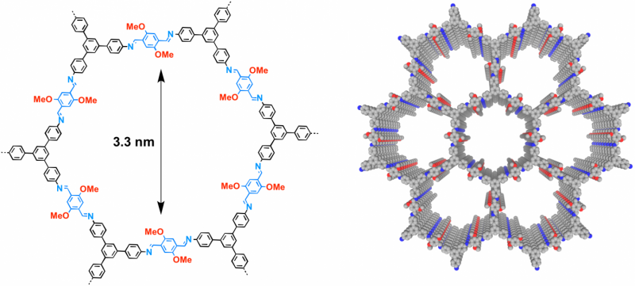
Introduction to Nanoporous Materials
Zeolites
Nanoporous materials: contain pores on the order of few Angstroms to nanometers.
Different classes of materials exist: zeolites, MOFs, COFs, etc.
Large surface area and high tunability.
Metal-organic frameworks
(MOFs)
Covalent organic frameworks (COFs)

Slide 7
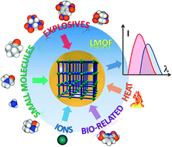
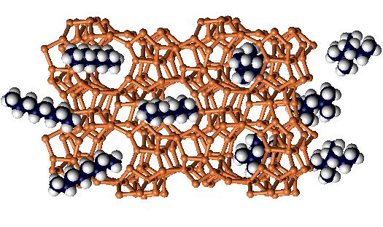
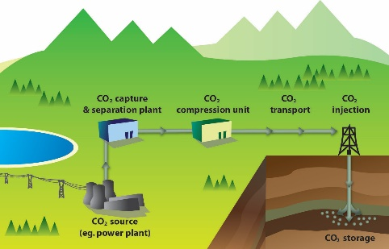
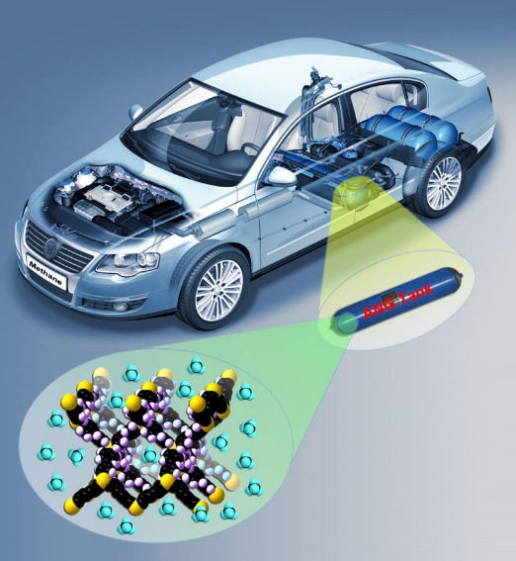

Potential Applications of Nanoporous Materials
Sensor
Catalysis
Porous
Materials
S.M. Auerbach et al., “Handbook of zeolites science and technology”, CRC press (2003).
P. Kumar et al, TrAC 73, 39 (2015).
Z. Hu et al., Chem. Soc. Rev. 43, 5815 (2014).
Gas Separation
(e.g., carbon capture, pollutant removal)
Gas Storage
(e.g. H₂/CH₄ storage, ANG vehicle)
D.M. D’Alessandro et al., Angew. Chem. Int. Ed. 49, 6058 (2010).
N.A. Khan et al., J. Hazard Mater. 244-245, 444 (2013).
J.A. Mason et al., Chem. Sci. 5, 32 (2014).
M.P. Suh et al., Chem. Rev. 112, 782 (2011).

Slide 8

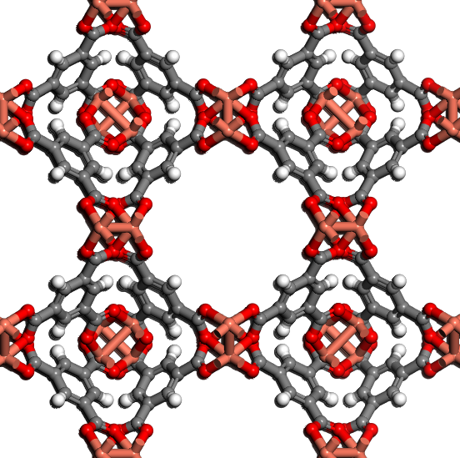
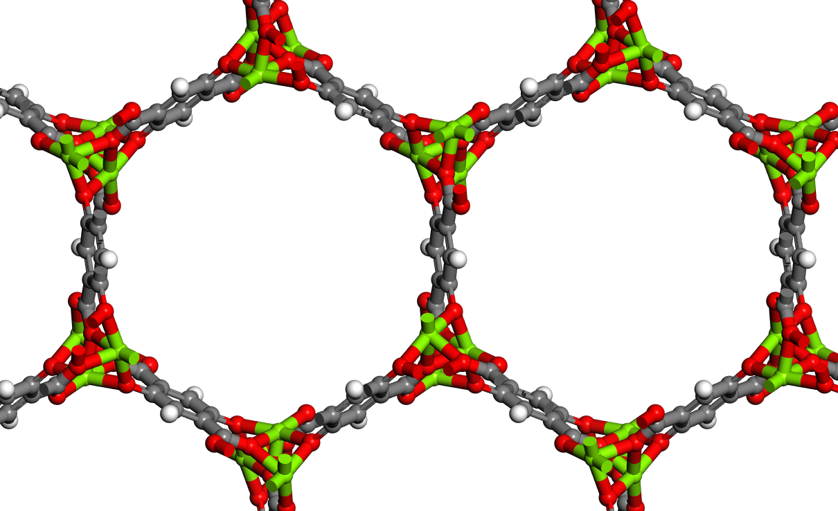
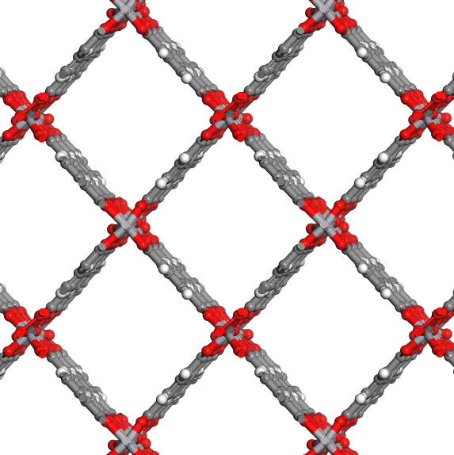
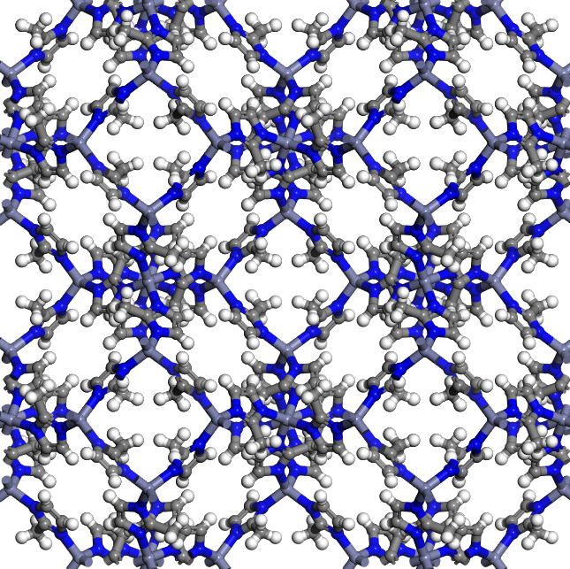
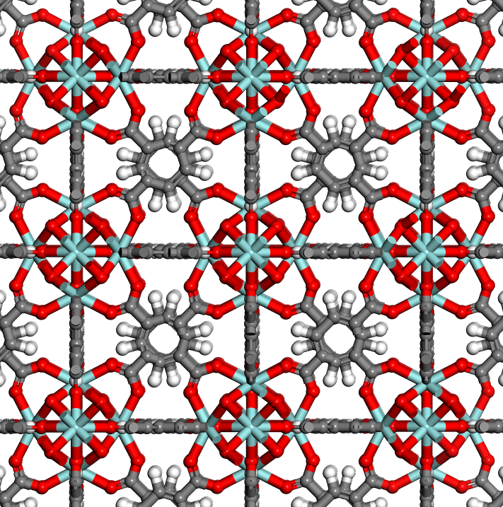
Can Artificial Intelligence (AI) Generate New Porous Materials?
??
Library of Existing Materials Some Neural Network New Materials
Basic Idea: millions of materials (e.g. zeolites, MOFs, polymers) exist
Existing zeolites, MOFs, polymers ➔ feed into artificial neural network (ANN)
After training on thousands (millions) of materials, can AI generate new materials?
8

Slide 9

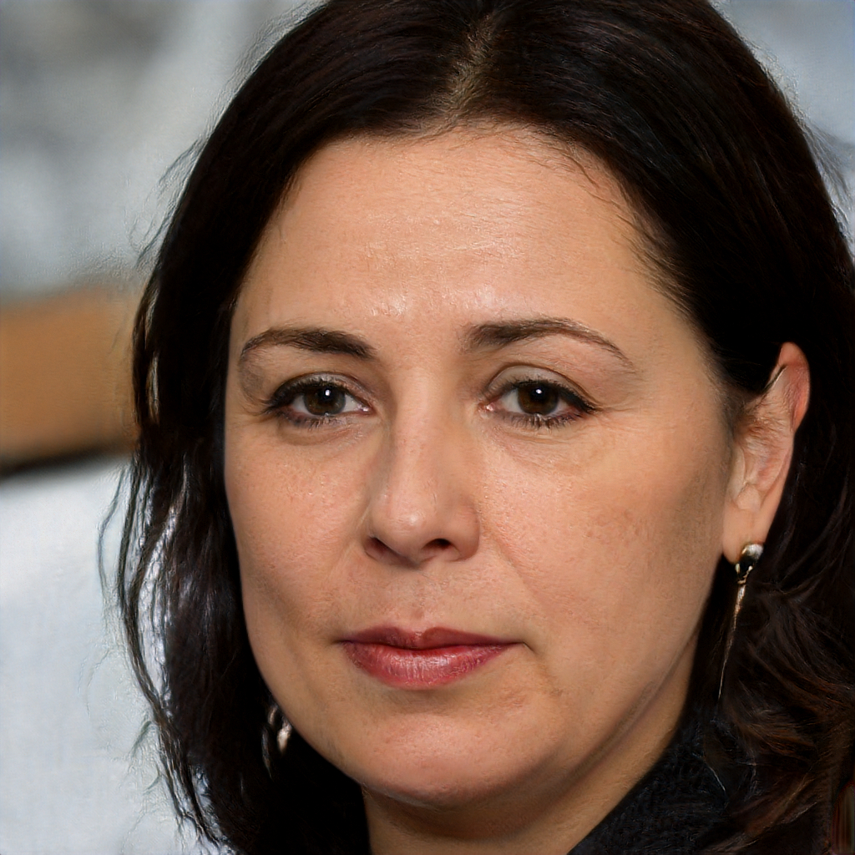
AI Generating Human Face
www.thispersondoesnotexist.com

Slide 10
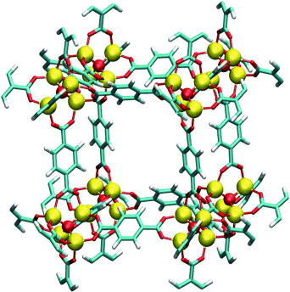
Generating Human Faces vs Generating Materials

Slide 11
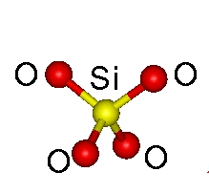
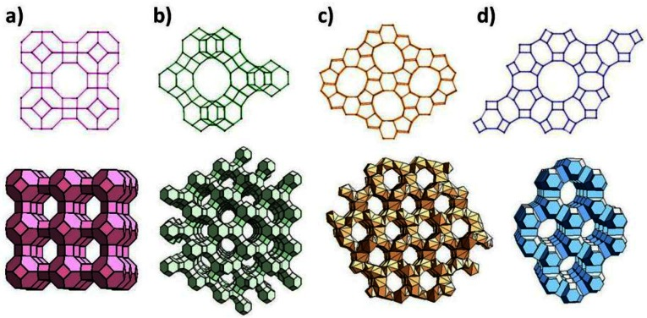
Pure-silica Zeolites
Porous material: pure-silica (Si, O) zeolites
Experimentally determined zeolites (IZA): 234 zeolites
Computationally discovered zeolites (PCOD): ~330,000 zeolites
Target property: methane (CH₄) adsorption
Training set: ~30,000 zeolites
Test set: ~30,000 zeolites
Zheng, Y., Li, X. & Dutta, P. K. Sensors 12, 5170–5194 (2012).

Slide 12
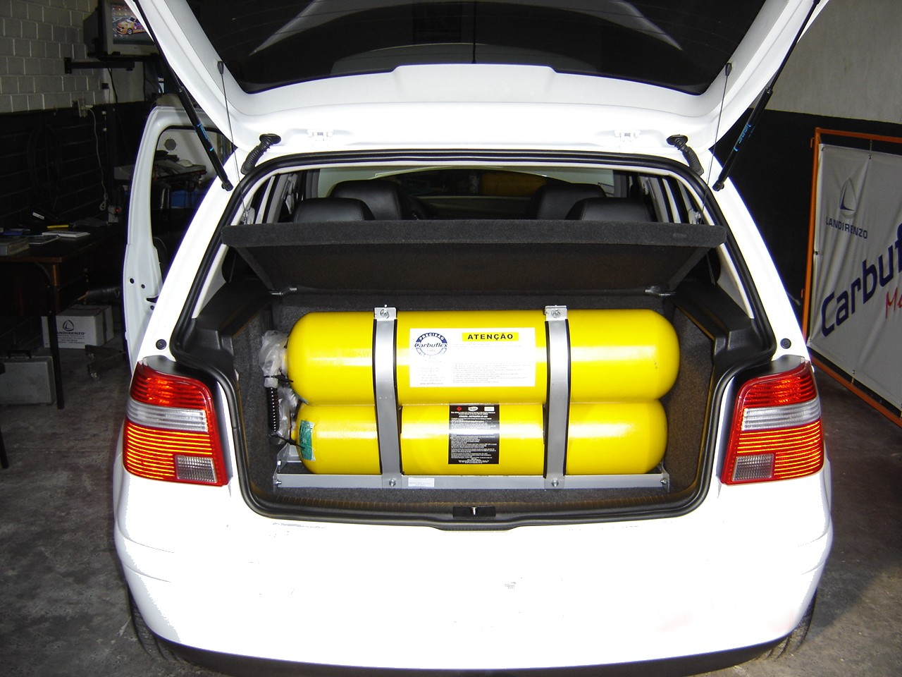
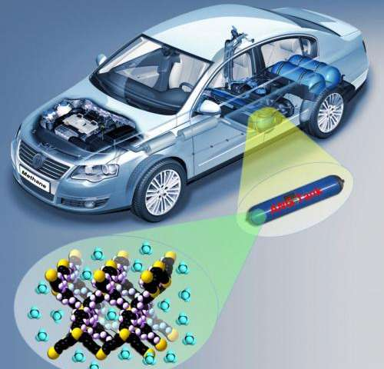
Case Study Application: Adsorbed Natural Gas (ANG) Vehicles
CNG
Recently, US DOE was interested in the adsorbed natural gas (ANG) vehicle technology.
Compared to the compressed natural gas (CNG) vehicle, the storage is at mild conditions (T = 298 K, P = 35-65 bar).
The DOE target for ANG was set at methane working capacity of 315 cm³/cm³, which would make ANG comparable to CNG.
However, after years of research (i.e. millions of dollars spent), the best material only has around working capacity of 200 cm³/cm³.
??
ANG

Slide 13
Which ANN? Generative Adversarial Network (GAN)
Most popular generative ANN (developed in 2014)
GAN has two main neural networks (Discriminator and Generator); Example
Generative
Model (Thief)
Random Noise
Discriminative
Model (Police)
Fake Money
Real or Fake?
Real Money
https://www.kdnuggets.com/2016/07/mnist-generative-adversarial-model-keras.html

Slide 14
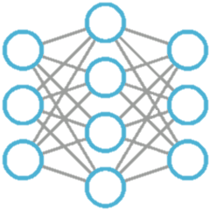
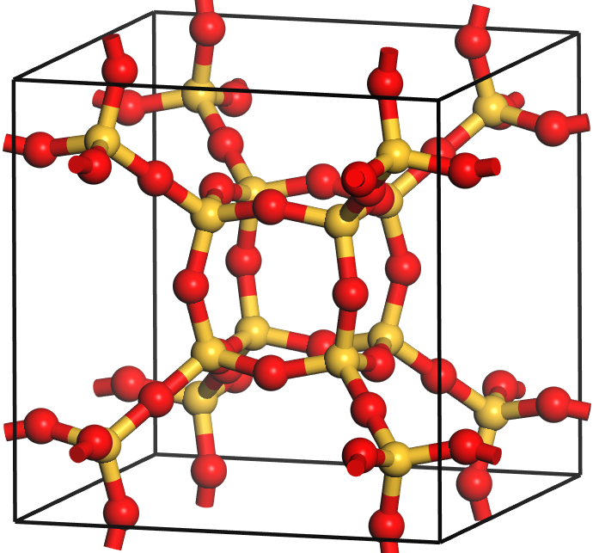
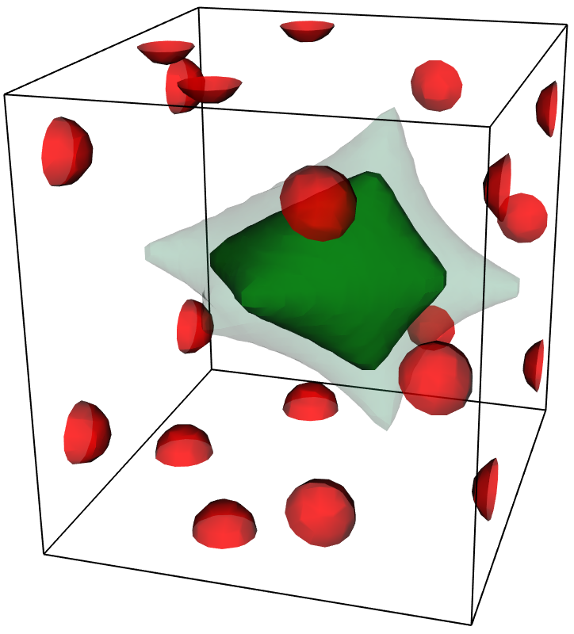
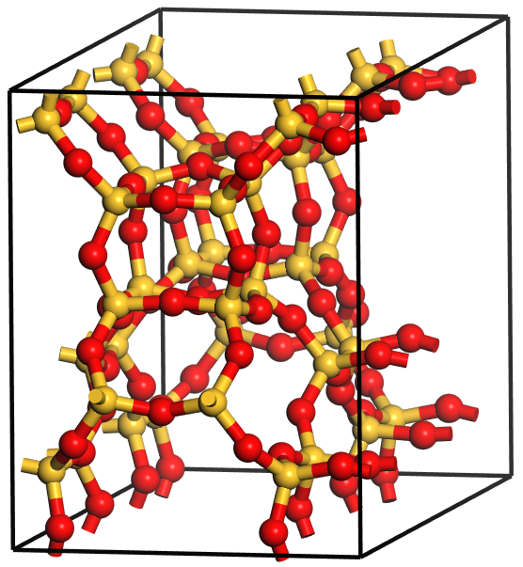

Objective of the Zeolite Project
1) A generative model for zeolites
2) Fine tuning of user-desired adsorption property
+
ANN
Material/property
representation
ANN Architecture
for this representation
Porous material
generation
18-22 kJ/mol
ANN
19 kJ/mol

Slide 15
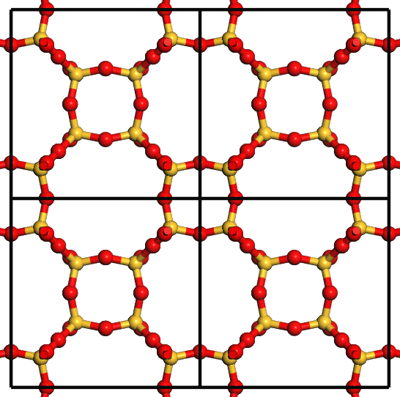
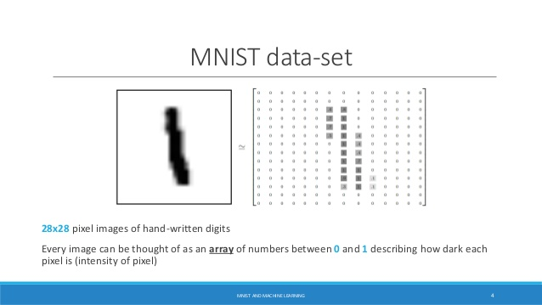
No Representations for Crystalline Material Generation Using Artificial Intelligence
EASY!!
DIFFICULT!!
Lattice information
(a, b, c, α, β, γ)
16
Periodic boundary conditions

Slide 16
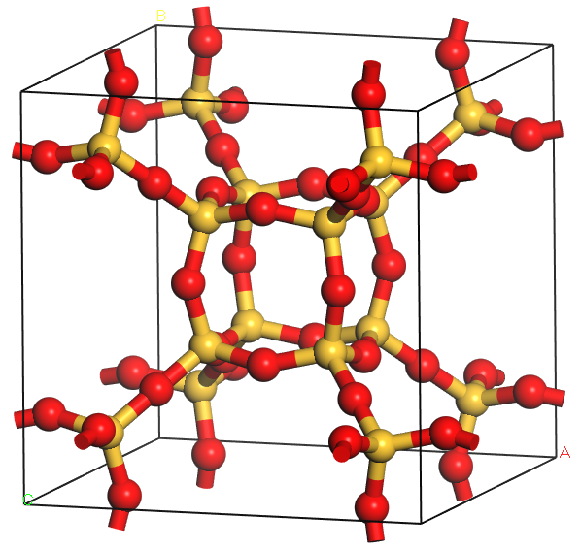
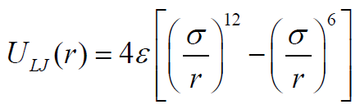
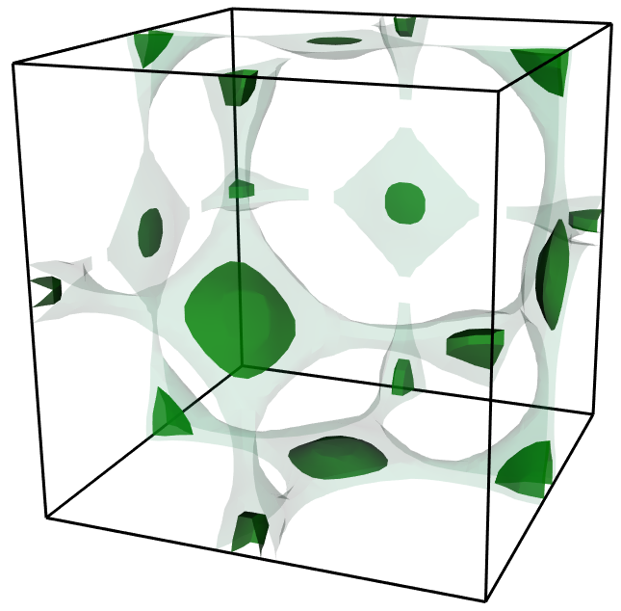
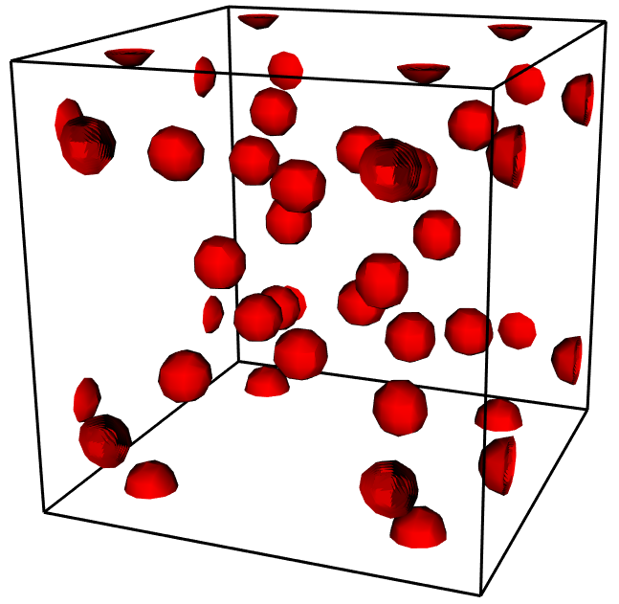
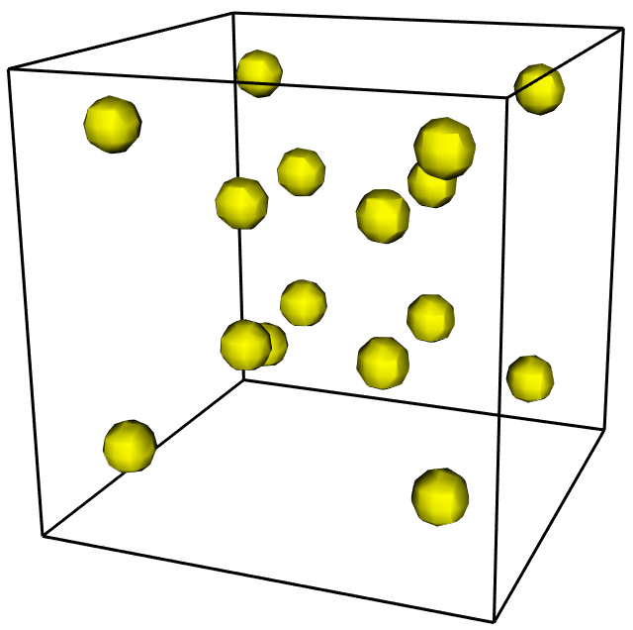
3D Shape(Grid) Representations
Lennard-Jones potential
Gaussian
$A ∗ \exp{(−\frac{{\left(x −x_{0}\right)}^{2}}{B}}$)
Energy shape
Material shape (O)
Material shape (Si)
Adsorption properties
(K_{H}, heat of adsorption, …)
Atomic positions

Slide 17
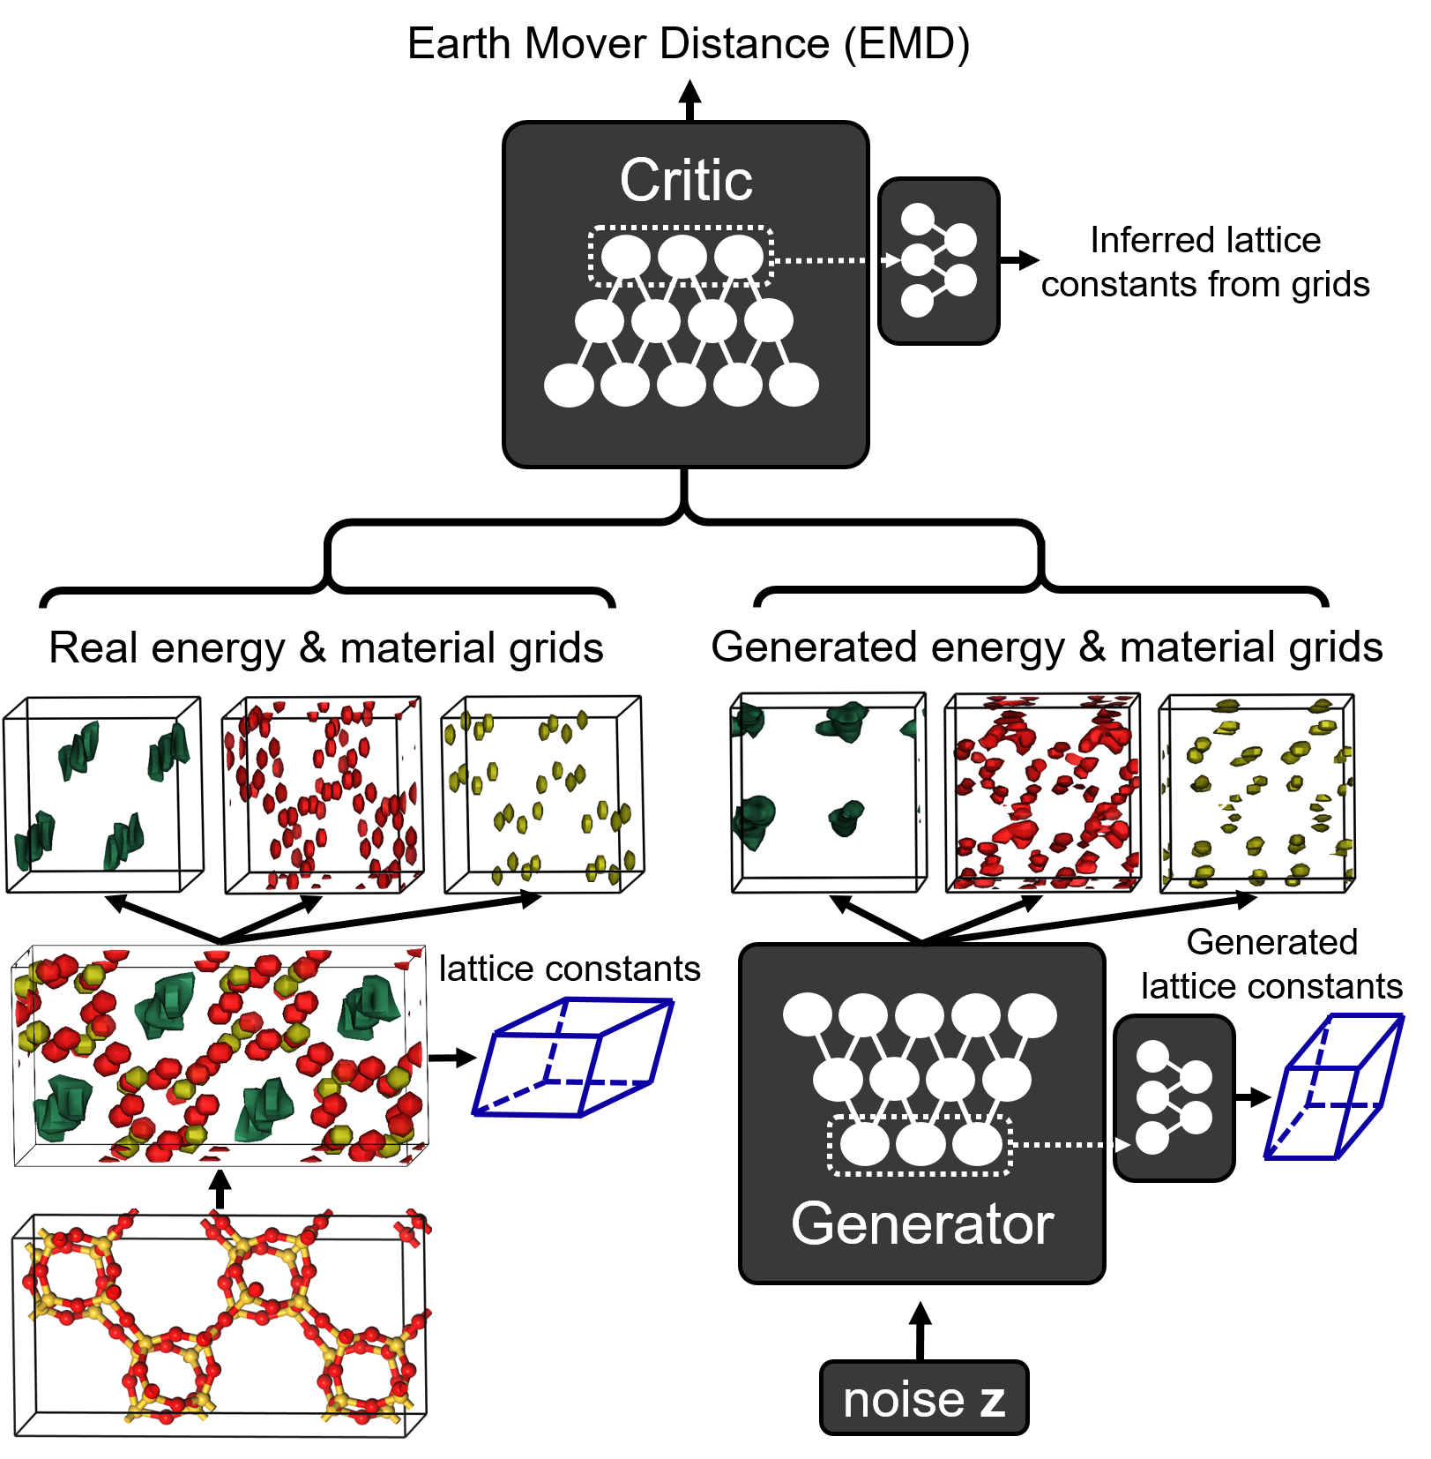
Generative Adversarial Network for Zeolites (ZeoGAN)
*S. Lee et al., Journal of Materials Chemistry A 7, 2709 (2019).
*B. Kim et al., Science Advances 6, eaac9324, (2020).

Slide 18
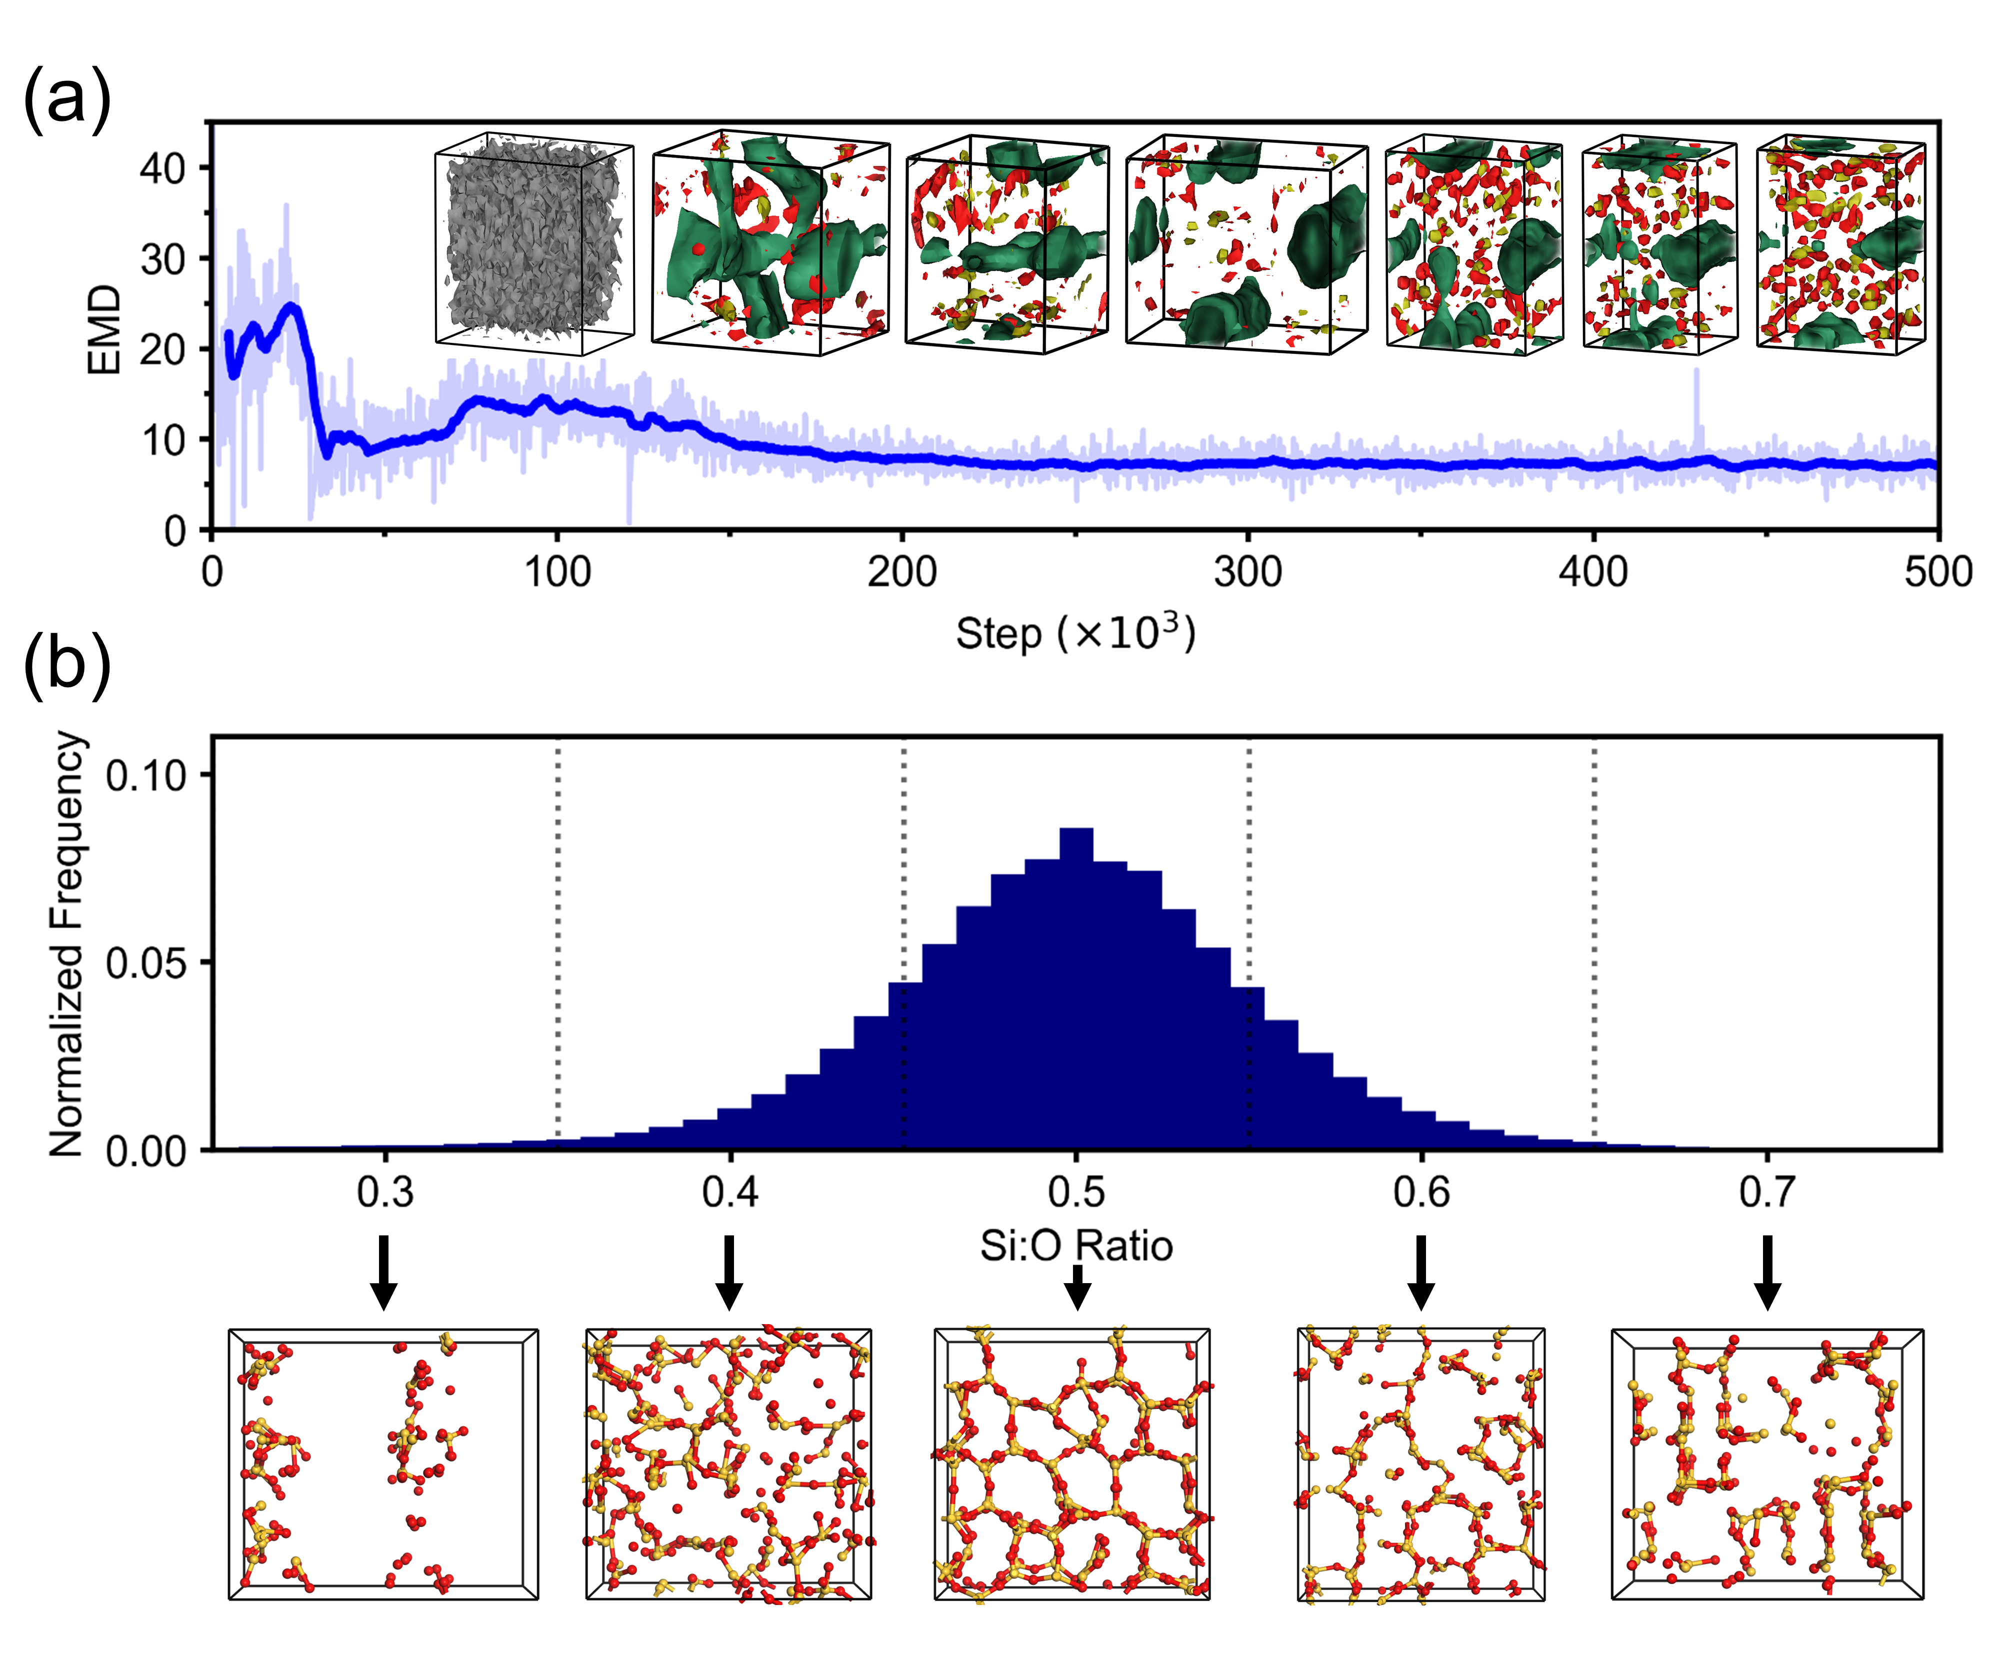
Convergence of ZeoGAN
Earth-Mover Distance (EMD)
distance between Real/Generated data distributions
determines when to stop the neural network simulations

Slide 19
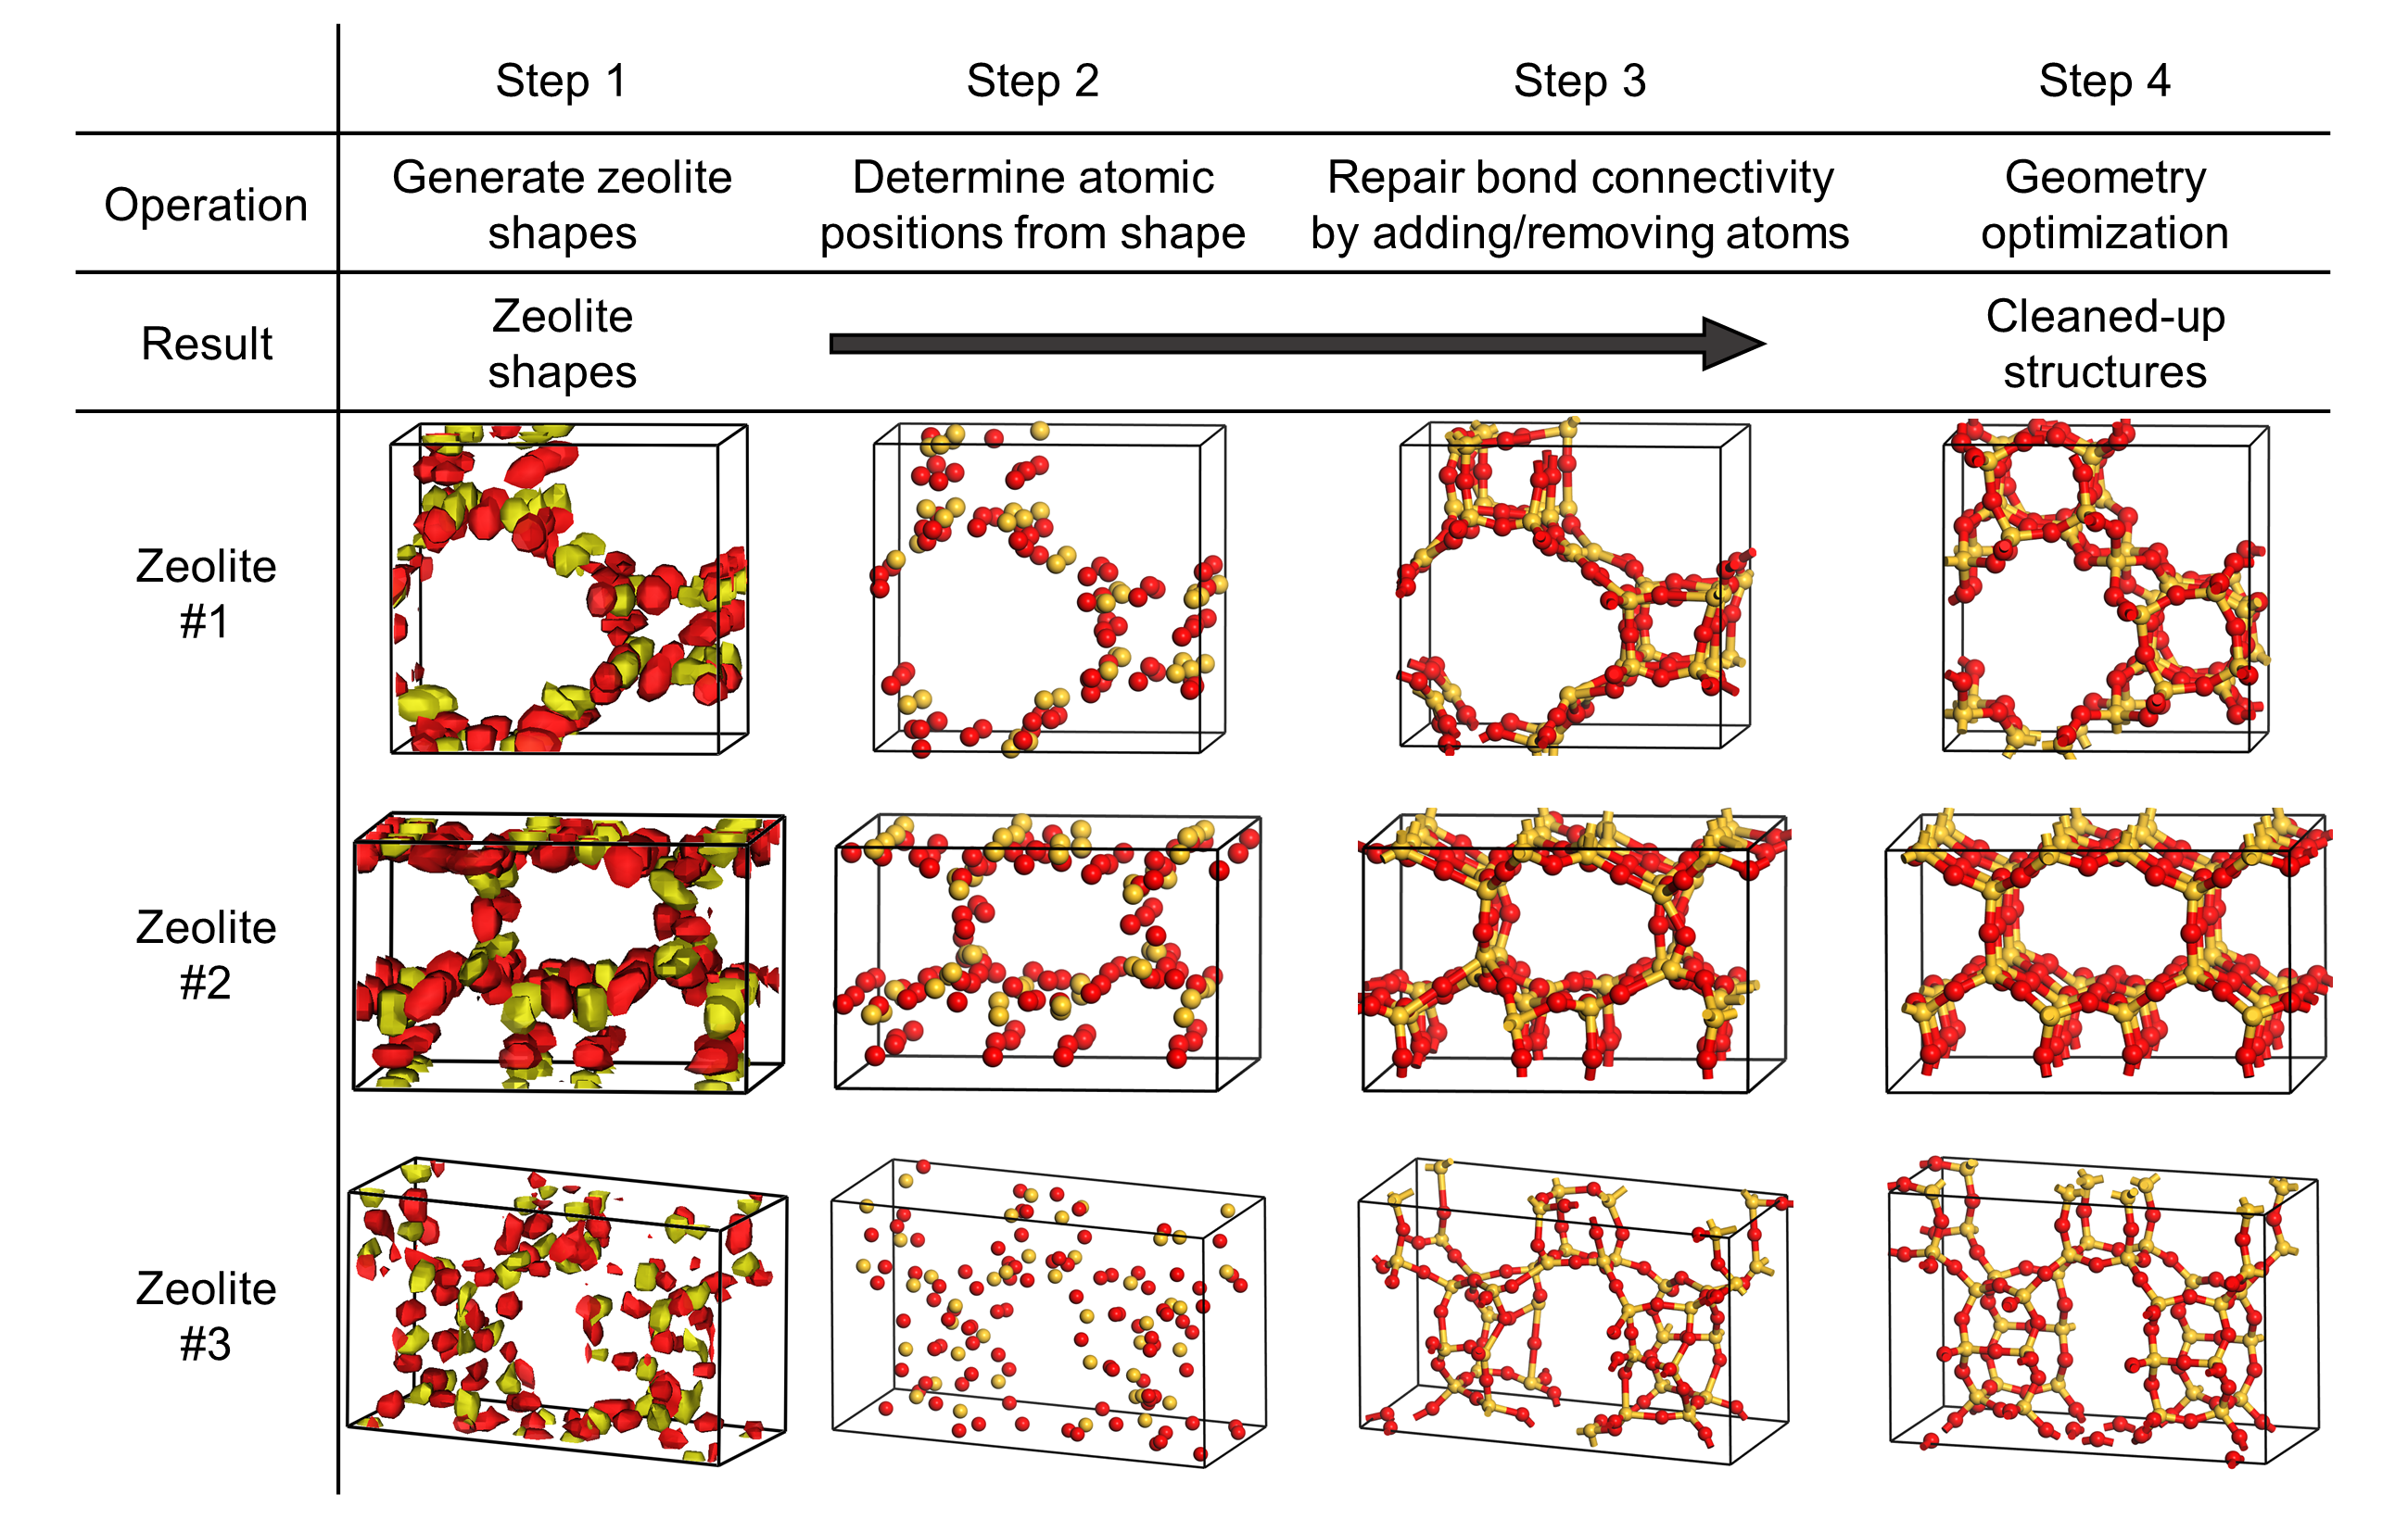
Zeolite Cleanup Algorithm

Slide 20
Generated Zeolites Statistics
1 million zeolite-like shapes were generated.
Only ~120 fit the criterion of real zeolites (Si:O = 0.5, all the bond types/lengths/angles reasonable).
There is still much work to be done to improve the statistics.

Slide 21
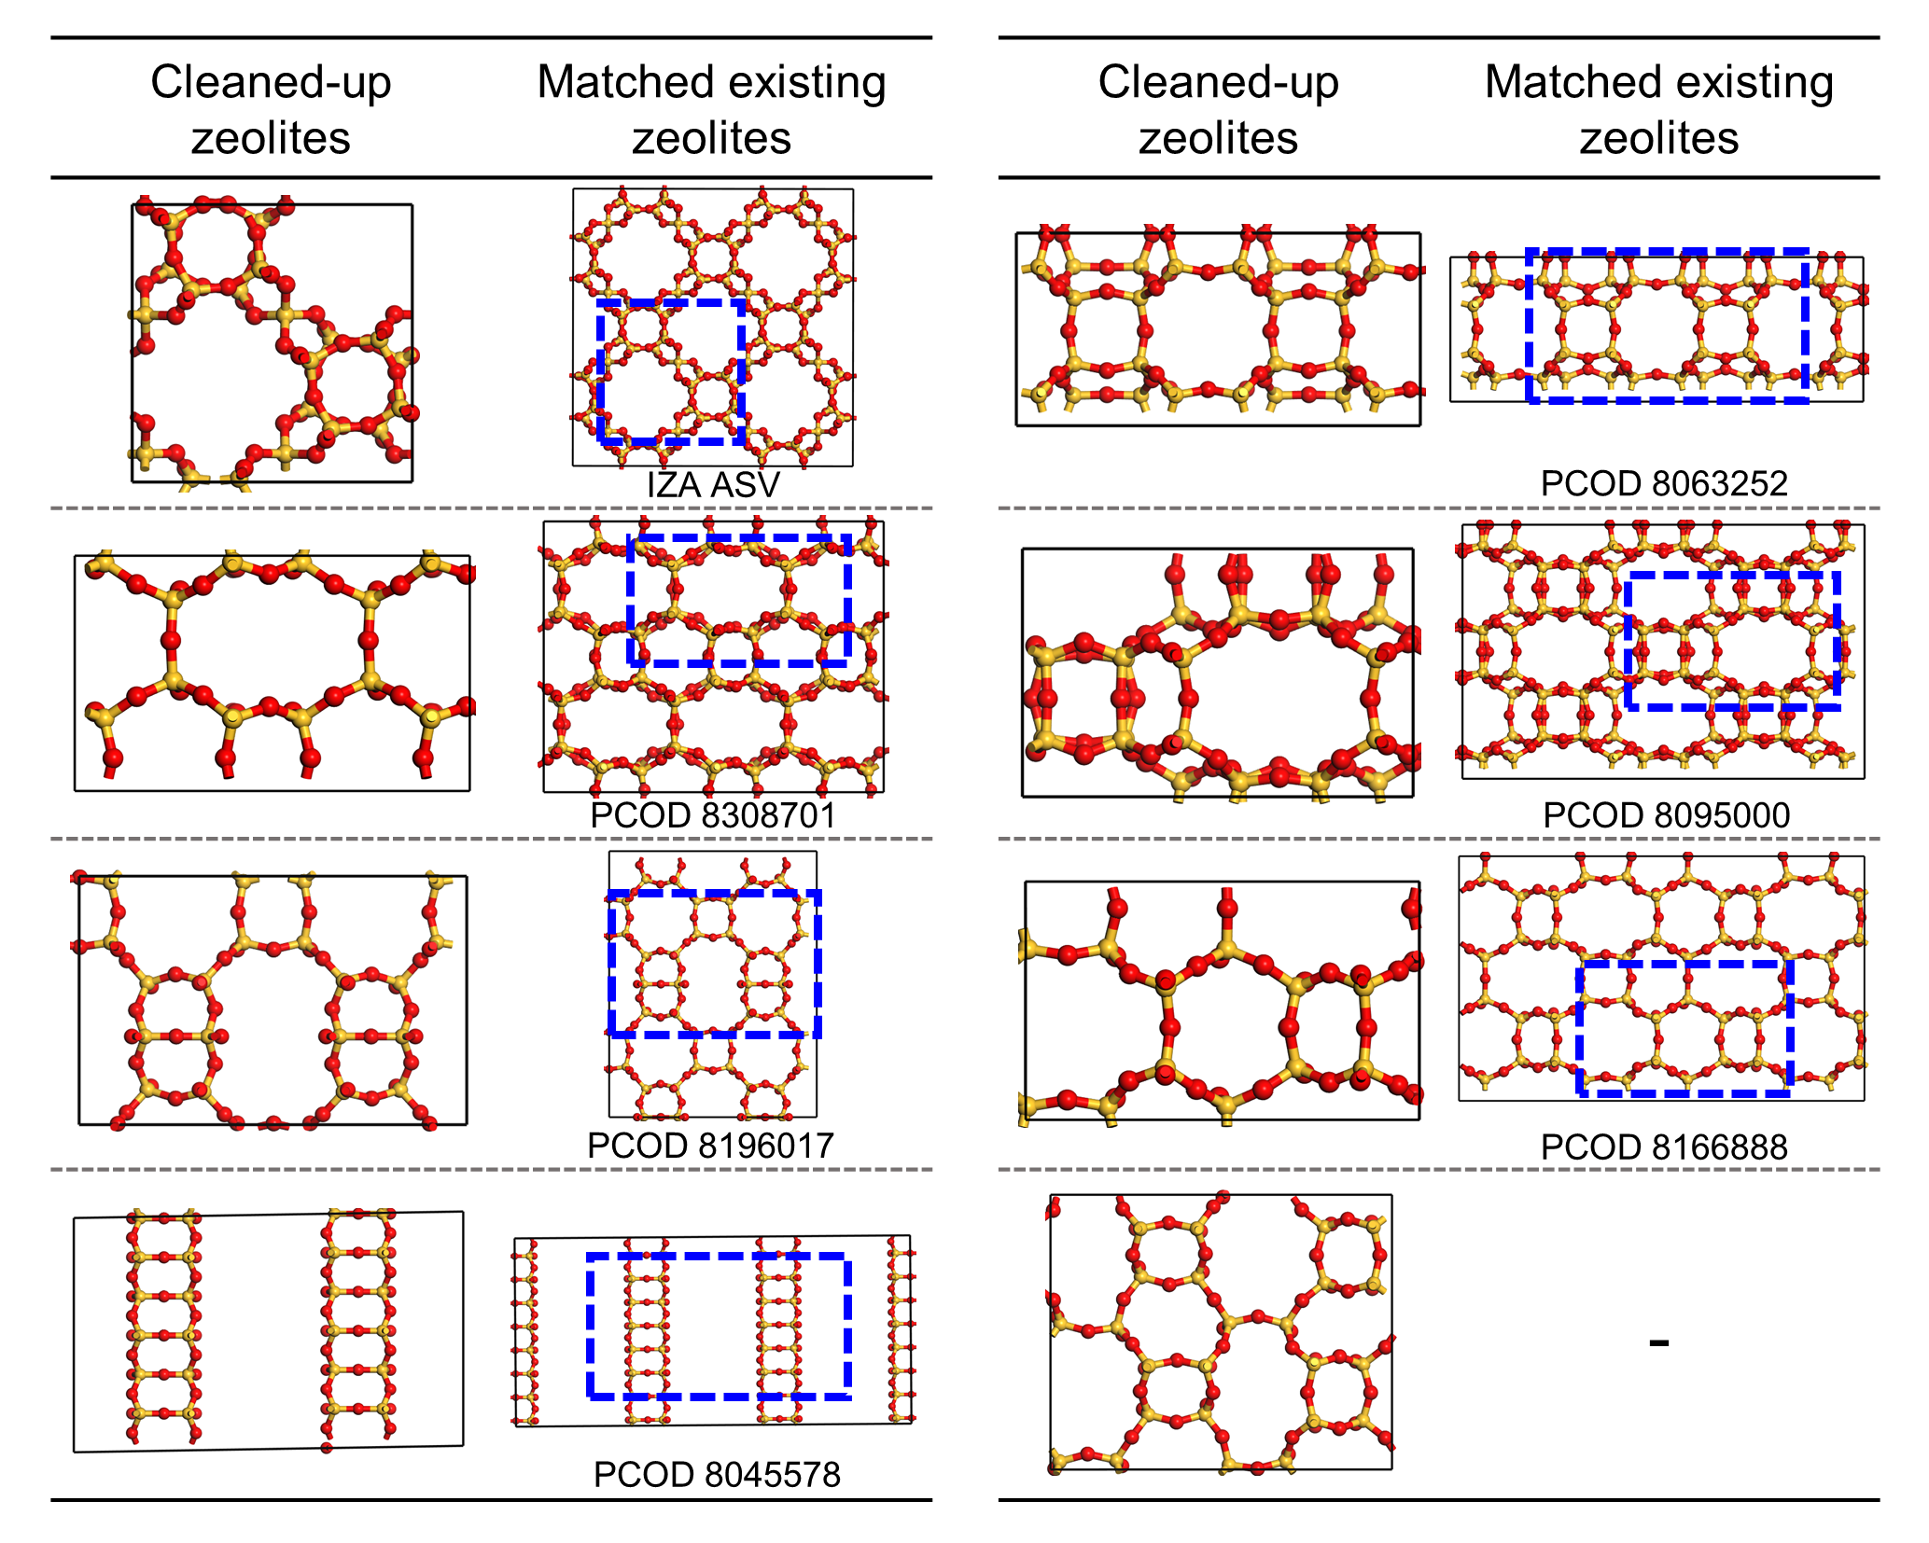
Generated Zeolites vs. Existing Zeolites

Slide 22
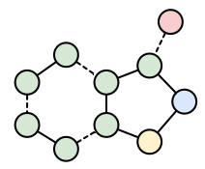



Is Inverse Design Possible in Our Work?
Material design today
Inverse design using AI
Material
Concept
Synthesis/
Generation
AI
Testing

Slide 23
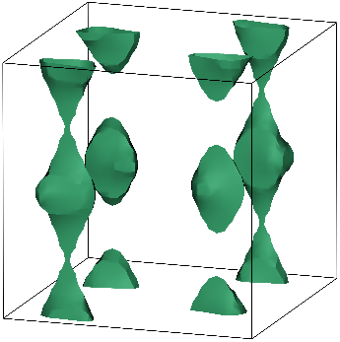
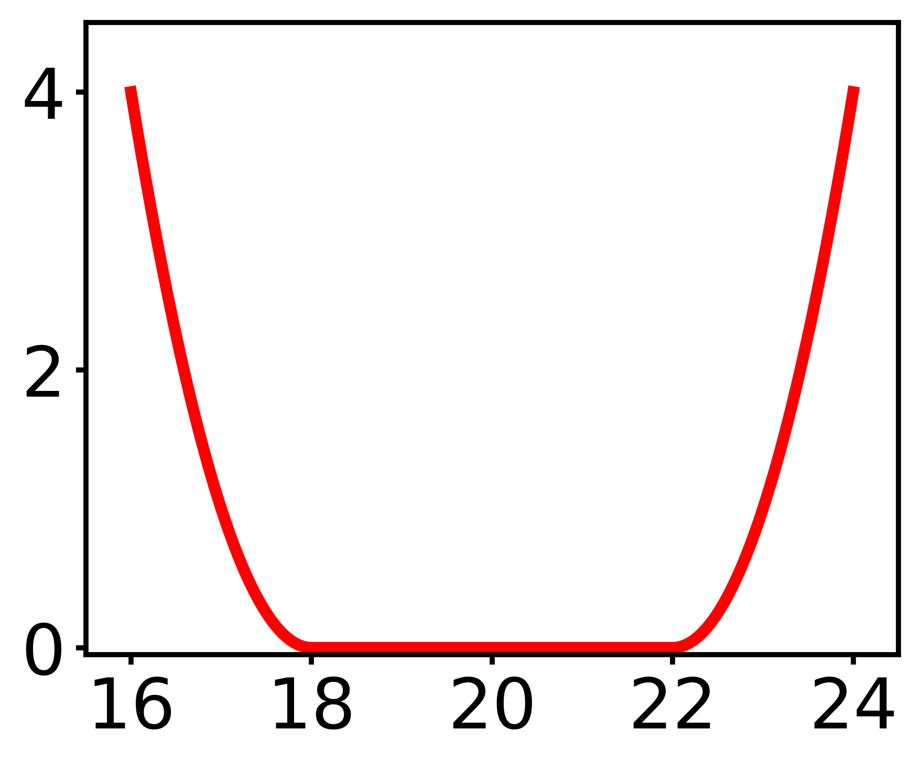
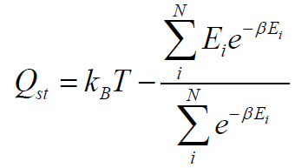
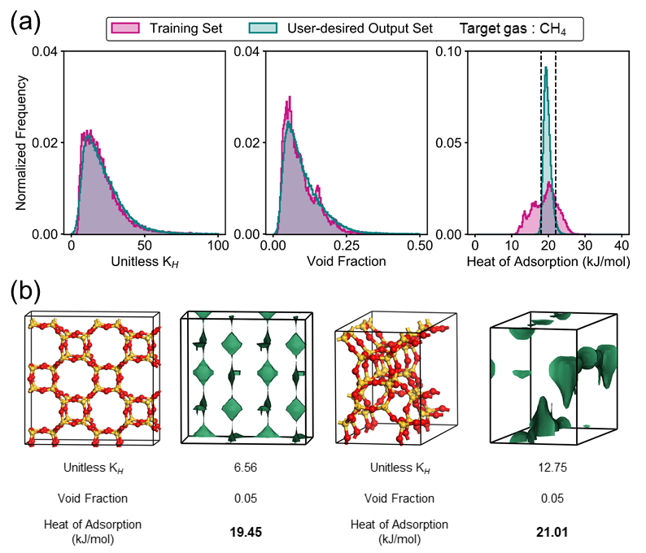
Generated User-desired Zeolites
User-desired loss
(18 to 22 kJ/mol)
Energy Shape
Heat of adsorption
$$Q_{st}(\frac{kj}{mol})$$

Slide 24
Generated User-desired Zeolites
Target heat of adsorption value: 18 ~ 22 kJ/mol

Slide 25
Zeolites vs MOFs (a.k.a. Coordination Polymers)
Zeolites
Metal-organic frameworks
(MOFs)
Nanoporous materials: contain pores on the order of few Angstroms to nanometers.
Different classes of materials exist: zeolites, MOFs, COFs, etc.
Large surface area and high tunability.
Crystalline
Porous
Chemically Simple (pure silica)
Crystalline
Porous
Chemically Complex

Slide 26
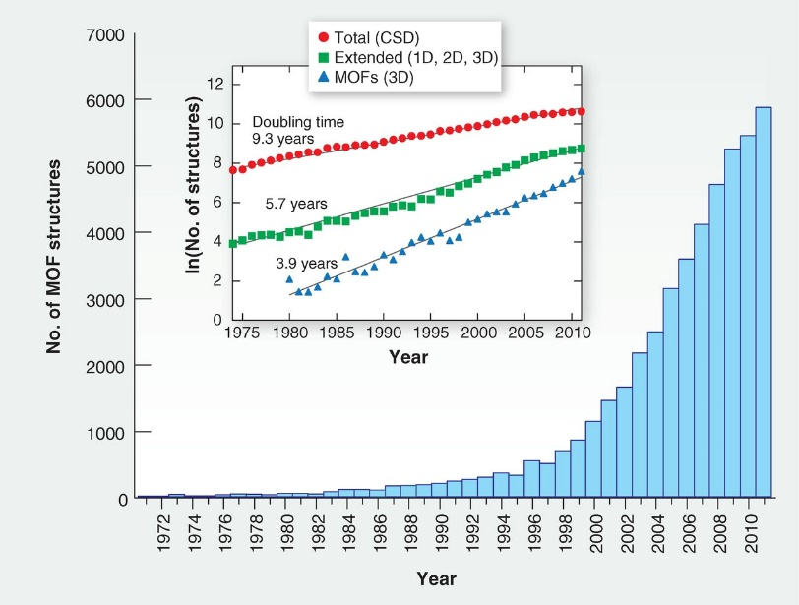
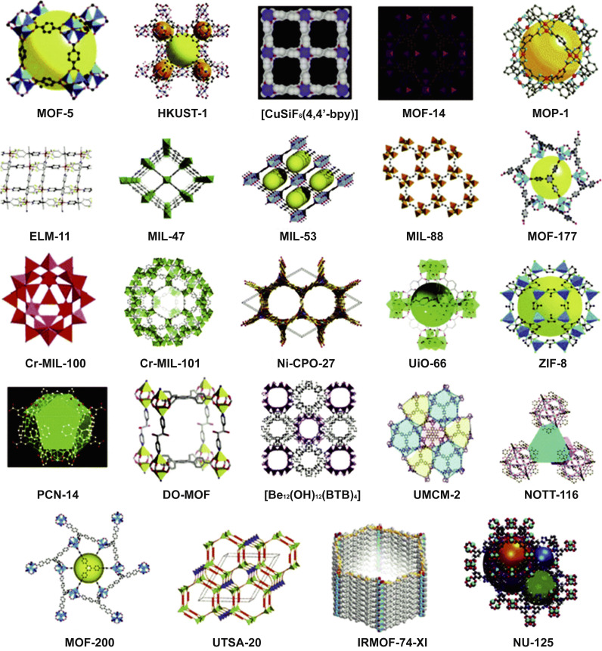
Number of MOFs is Increasing Rapidly
Experimental MOFs
The number of MOFs is increasing rapidly (Over 70,000 experimentally synthesized MOFs and many more number of hypothetical materials exist).
Big data set does exist even for just the experimental structures.

Slide 27
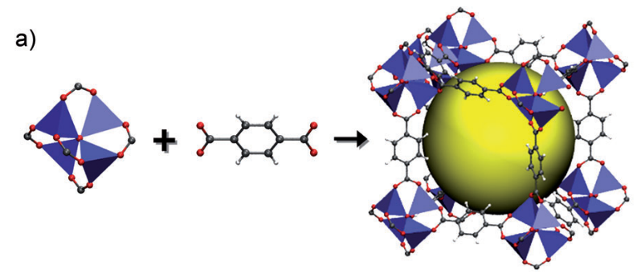
Different Representation of MOFs
One of the key features of MOFs is its modularity.
There are hundreds of different metal clusters and hundreds of different linkers.
And they can be built in a facile manner for different combinations.
So we will use these “components” as a single cluster in representation for the AI.
Metal cluster
Organic linker
MOF

Slide 28
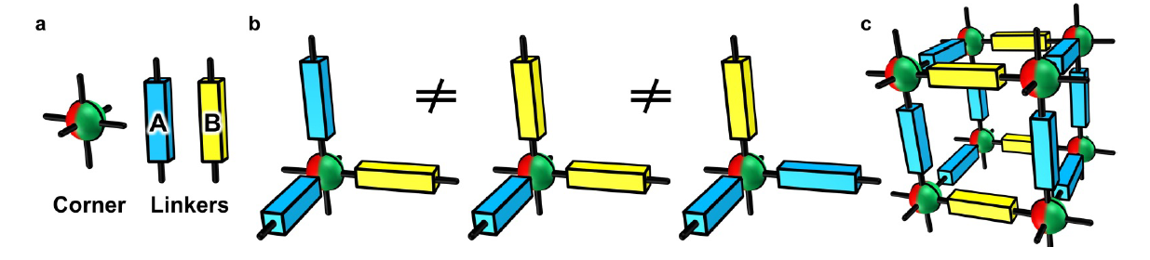
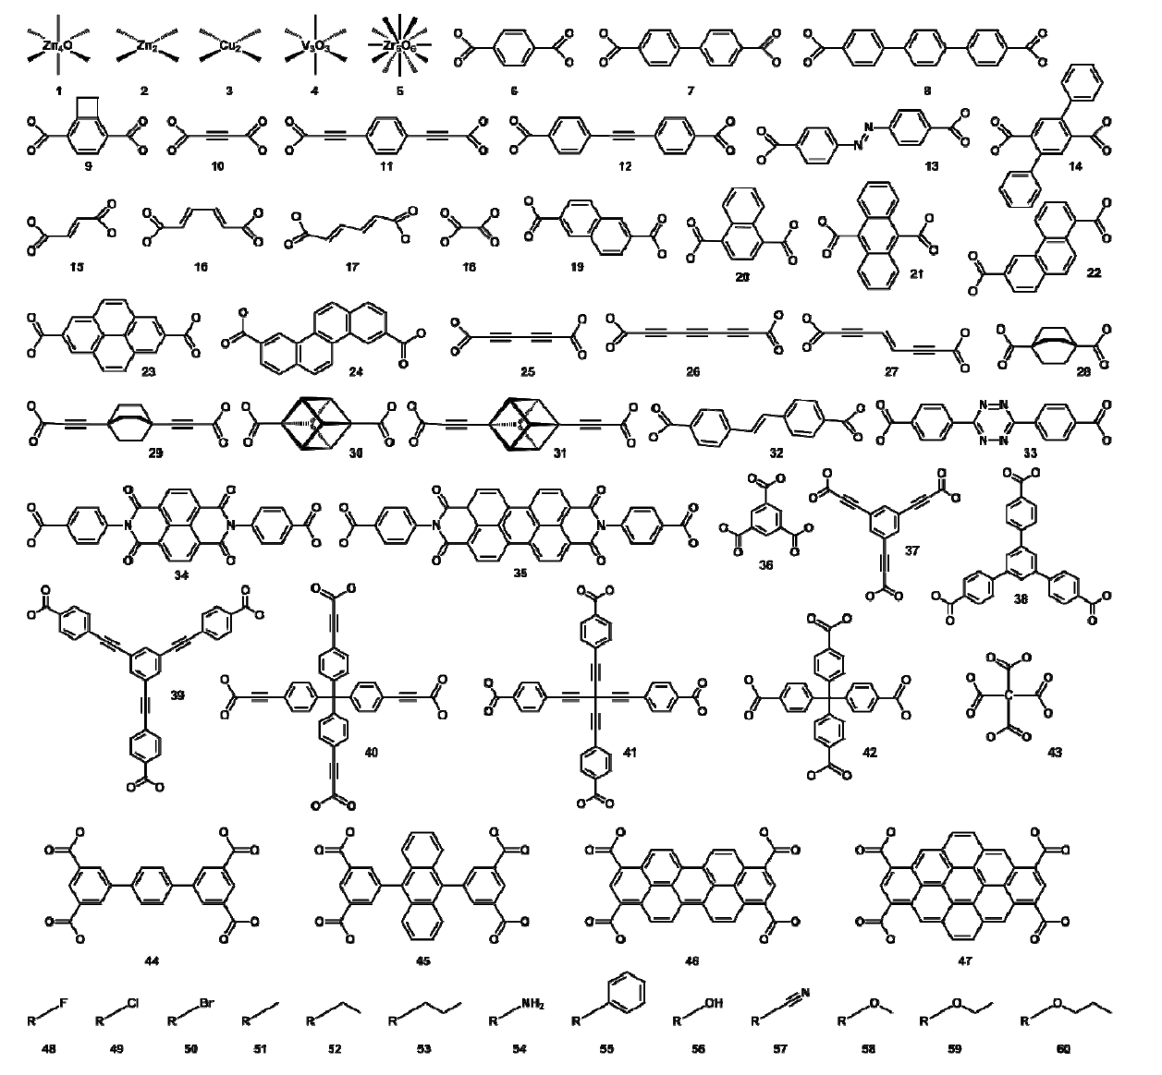
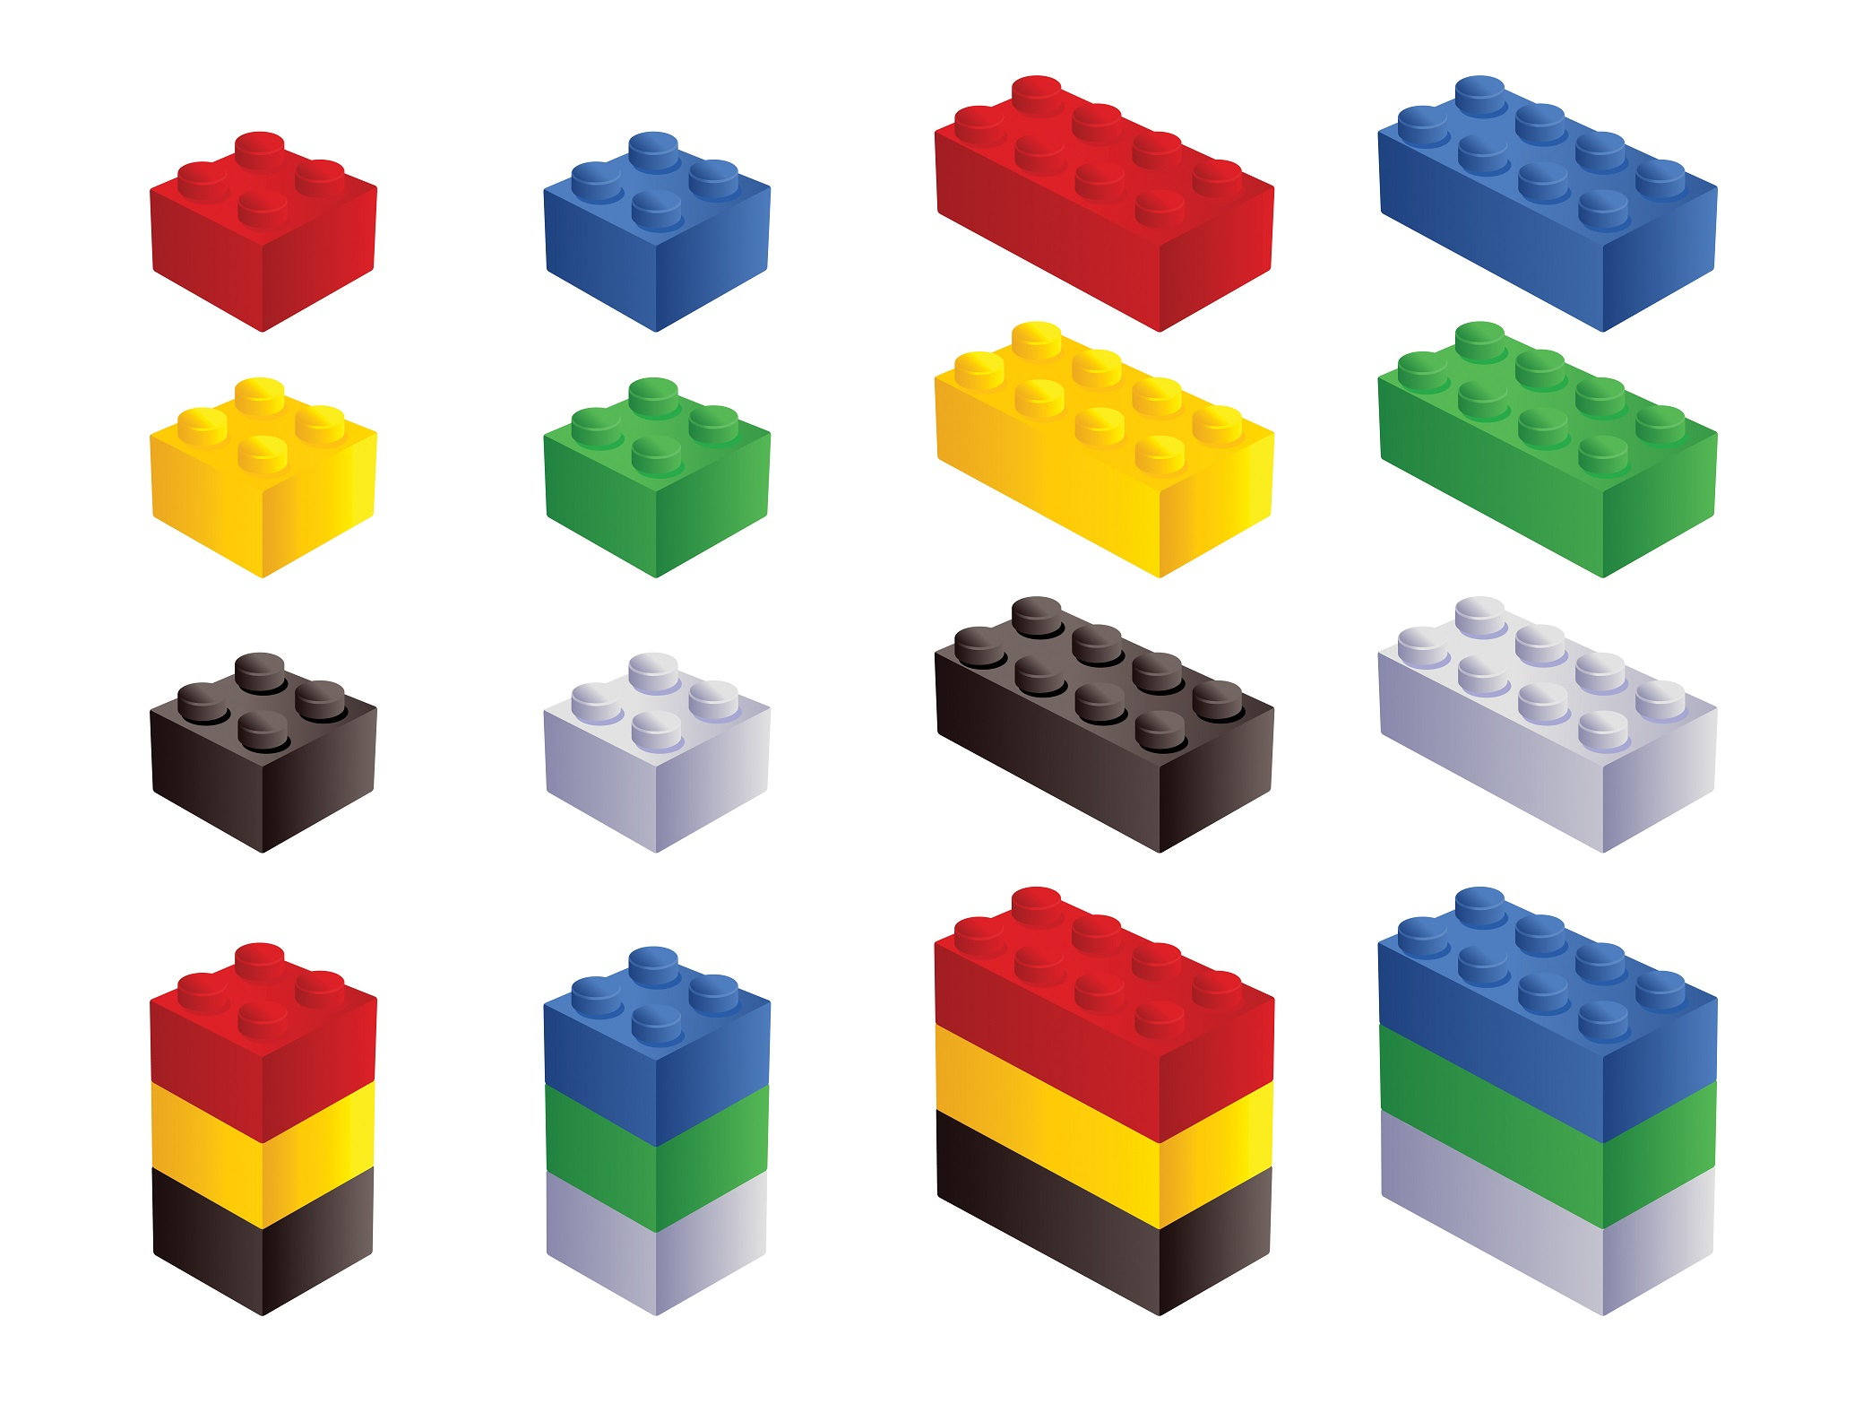
MOFs - Combinatorial Lego Building Blocks
C. Wilmer et al., Nat. Chem. 4, 83 (2012).

Slide 29
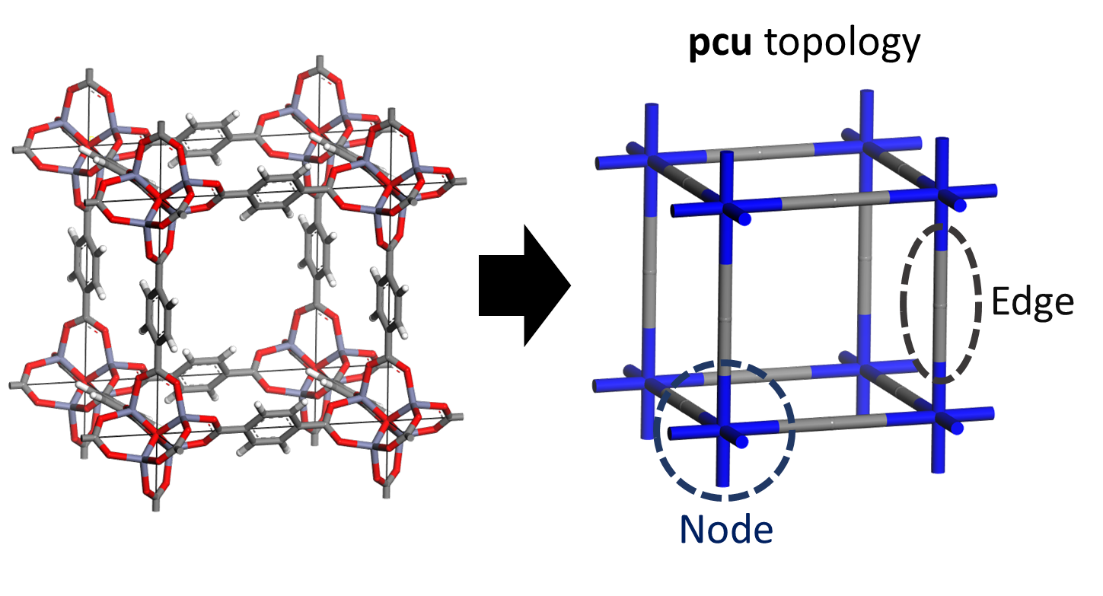
Node/Edge Abstraction for MOFs
The unit cell of each of these MOFs can be abstracted into node, edge, and known topologies. Example

Slide 30
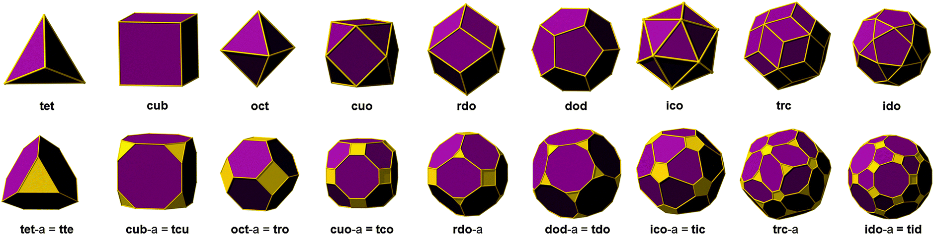
Topology for Different MOFs
There are more than 3000 topologies reported in the RCSR database.

Slide 31
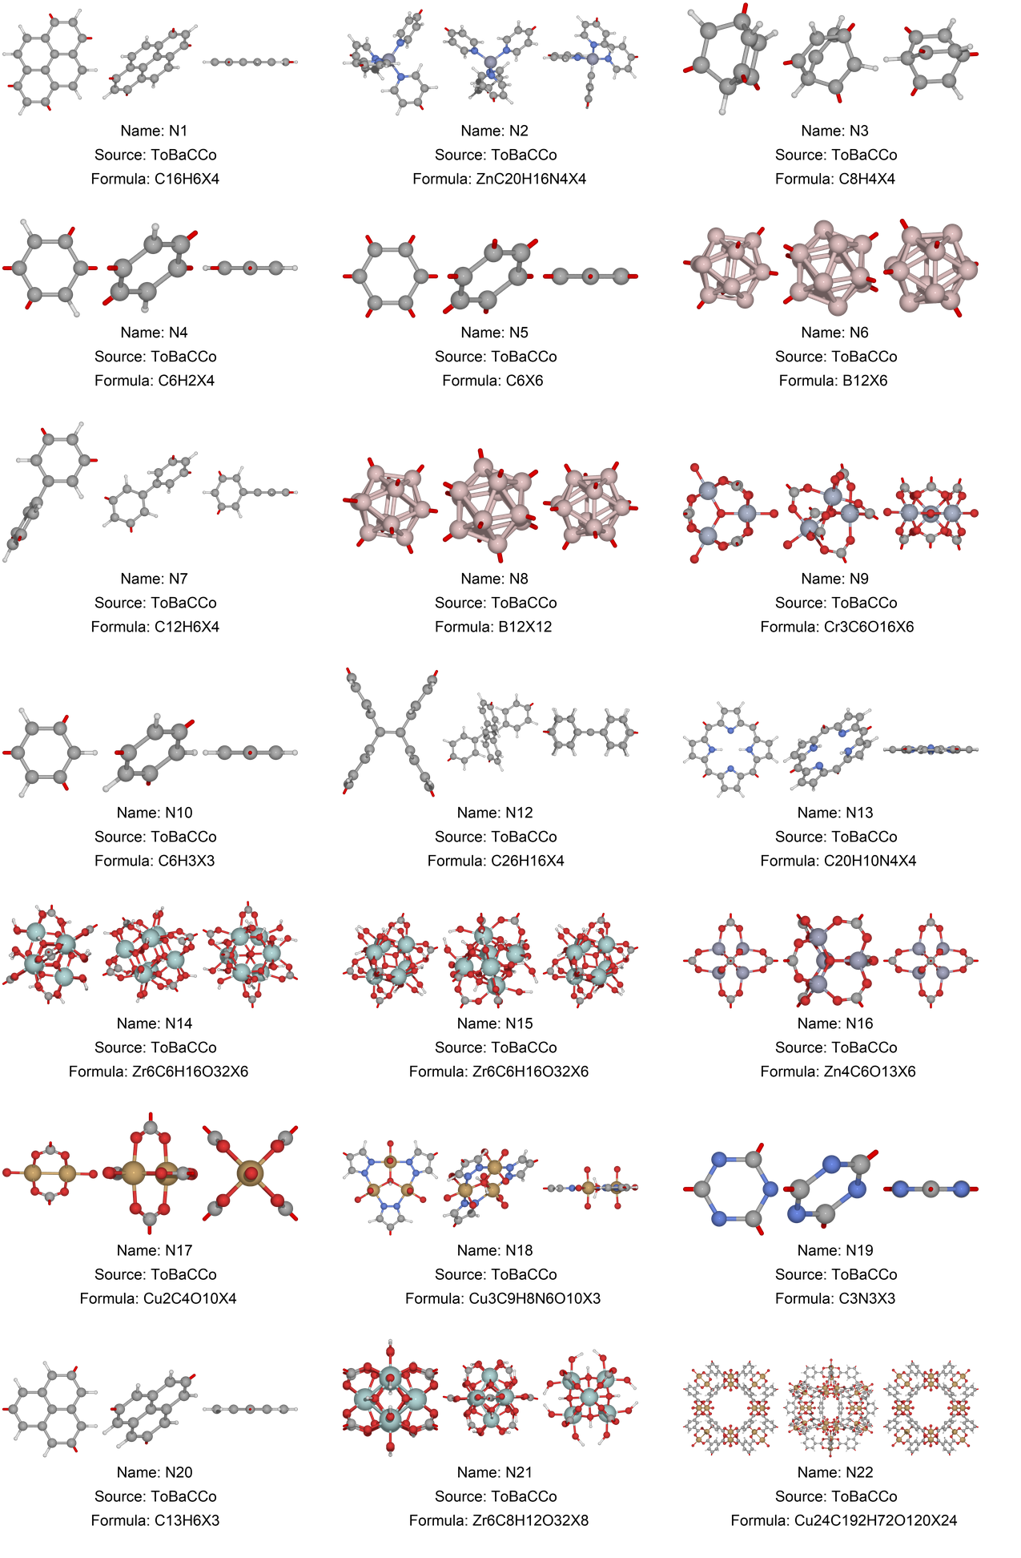

Node x Edge x Topology = Trillions of Possible MOFs
648 Node x 219 edge x 1775 topologies → 2.47 x 10¹⁴ Possible MOFs!!
This materials space is much larger than the 70,000 experimentally synthesized MOFs.

Slide 32


Component #1. Genetic Algorithm
Chromosome
Crossover operation

Slide 33

Component #2: MOF-NET
$$f\left(node, edge, topology\right)→methane working capacity$$

Slide 34

MOF-NET Performance for Methane Storage
MAE: mean absolute error
RMSE: root-mean-square error

Slide 35


Distribution of MOFs with Methane Working Capacity (WC)

Slide 36

Prediction of Record Breaking MOFs
*964 MOFs

Slide 37

Top Candidate MOFs

